Slide 1
Sartorious Experiments Summary Statistics

Slide 2
Table of best viscosity parameters: (manual testing)
 | Parameters: |  |  |  |  | % error (blowouts before)
Viscosity standard: | Aspiration rate: | Dispense rate: | Delay aspirate: | Delay dispense: | Time for 1000ul | 1000(ul) | 500(ul) | 300(ul)
204 | 185.0 | 18.0 | 10 | 10 | 80.960961 | -0.992463 | -0.665249 | -3.022089
398 | 80.0 | 15.0 | 10 | 10 | 99.166667 | -1.767441 | -1.275127 | -3.49754
505 | 50.0 | 5.0 | 10 | 10 | 240.000000 | -1.031009 | -1.581433 | -3.491137
817 | 10.0 | 5.0 | 10 | 10 | 320.000000 | -2.759218 | -3.829765 | -4.086789
1275 | 4.0 | 2.5 | 10 | 10 | 670.000000 | -2.467078 | -3.796428 | -2.442059

Slide 3
Table of best viscosity parameters: (BOTorch)

Slide 4
Table of best viscosity parameters: (IPOPT)

Slide 5
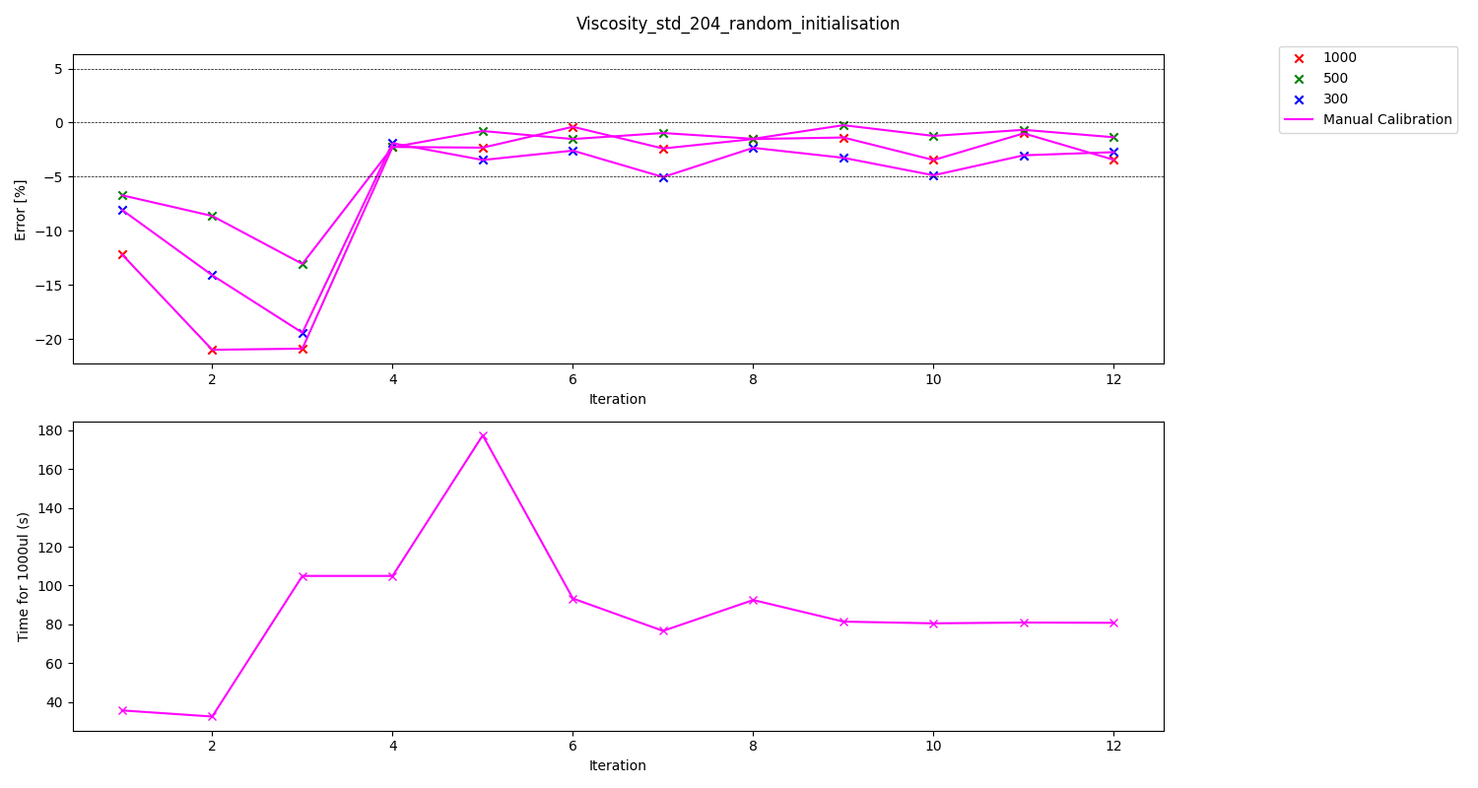
Graph of experiment results (Viscosity standard 204 manual)
 | Parameters: |  |  |  |  | % error (blowouts before)
Viscosity standard: | Aspiration rate: | Dispense rate: | Delay aspirate: | Delay dispense: | Time for 1000ul | 1000(ul) | 500(ul) | 300(ul)
204 | 185.0 | 18.0 | 10 | 10 | 80.960961 | -0.992463 | -0.665249 | -3.022089

Slide 6
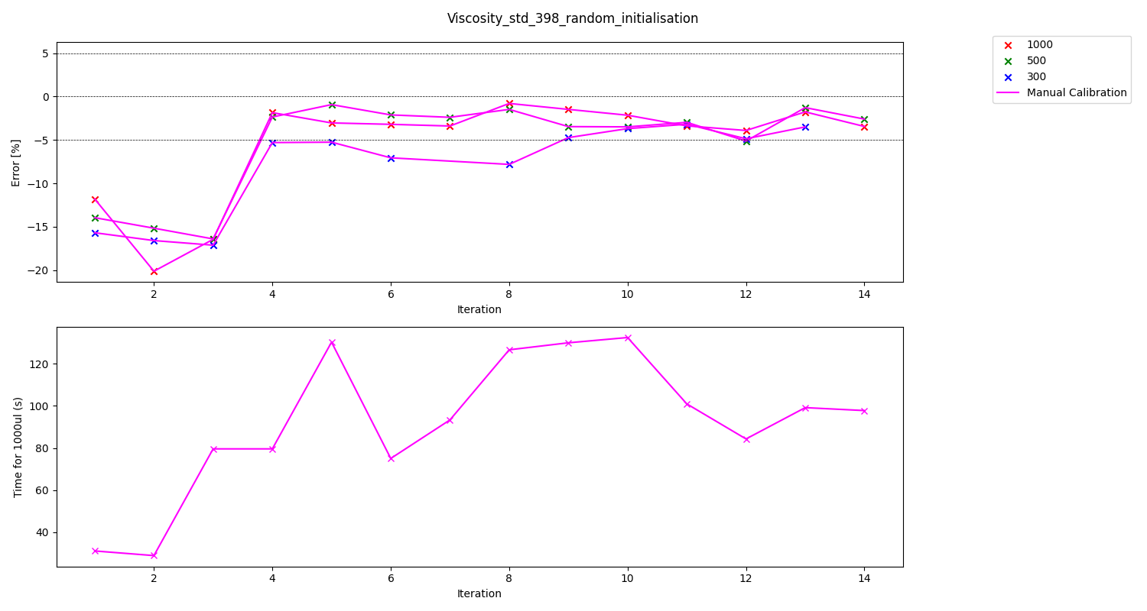
Graph of experiment results (Viscosity standard 398 manual)
 | Parameters: |  |  |  |  | % error (blowouts before)
Viscosity standard: | Aspiration rate: | Dispense rate: | Delay aspirate: | Delay dispense: | Time for 1000ul | 1000(ul) | 500(ul) | 300(ul)
398 | 80.0 | 15.0 | 10 | 10 | 99.166667 | -1.767441 | -1.275127 | -3.49754

Slide 7
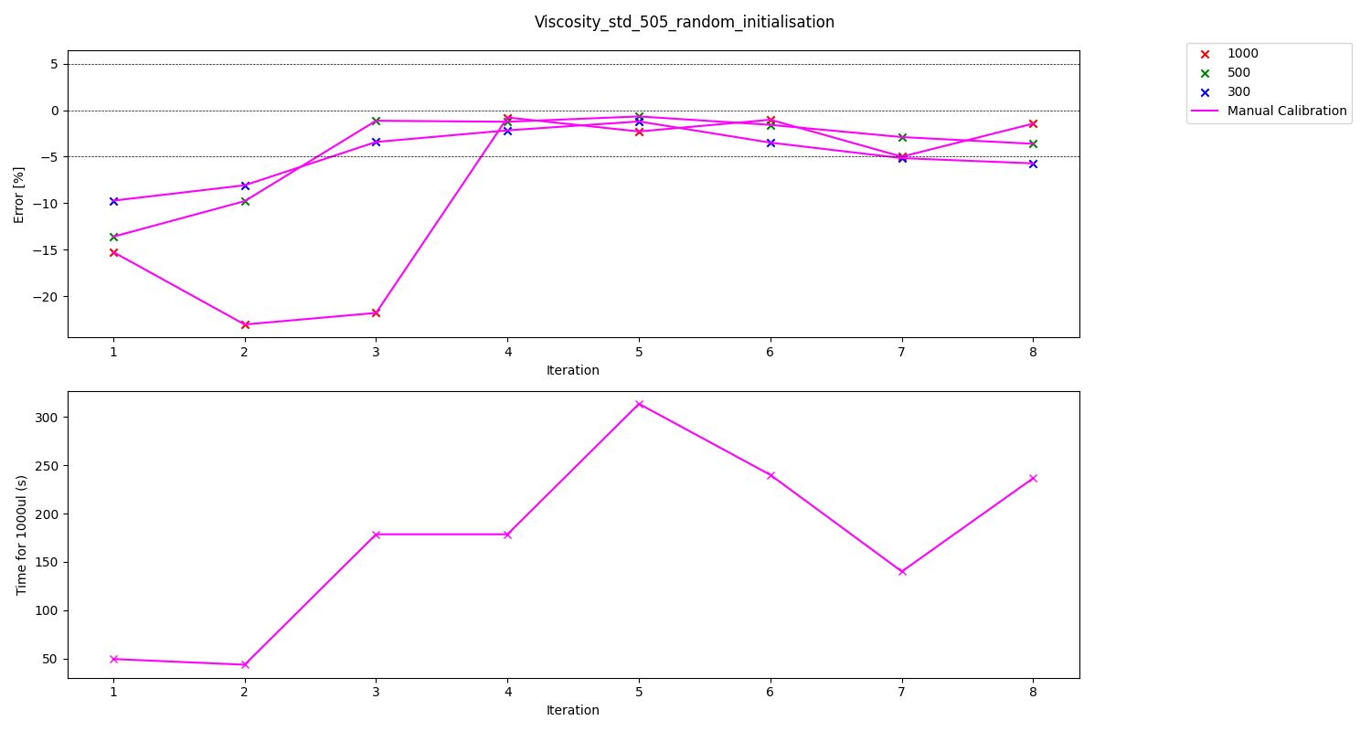
Graph of experiment results (Viscosity standard 505 manual)
 | Parameters: |  |  |  |  | % error (blowouts before)
Viscosity standard: | Aspiration rate: | Dispense rate: | Delay aspirate: | Delay dispense: | Time for 1000ul | 1000(ul) | 500(ul) | 300(ul)
505 | 50.0 | 5.0 | 10 | 10 | 240.000000 | -1.031009 | -1.581433 | -3.491137

Slide 8
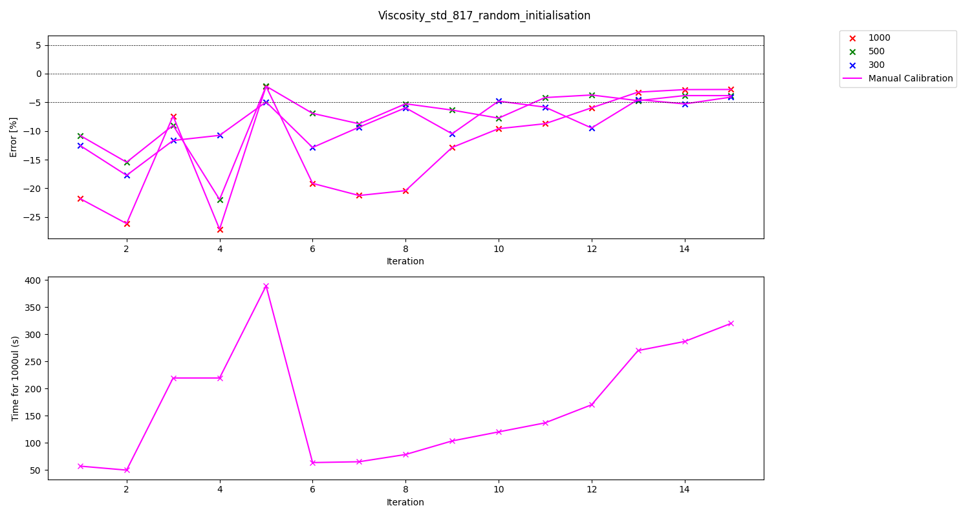
Graph of experiment results (Viscosity standard 817 manual)
 | Parameters: |  |  |  |  | % error (blowouts before)
Viscosity standard: | Aspiration rate: | Dispense rate: | Delay aspirate: | Delay dispense: | Time for 1000ul | 1000(ul) | 500(ul) | 300(ul)
817 | 10.0 | 5.0 | 10 | 10 | 320.000000 | -2.759218 | -3.829765 | -4.086789

Slide 9
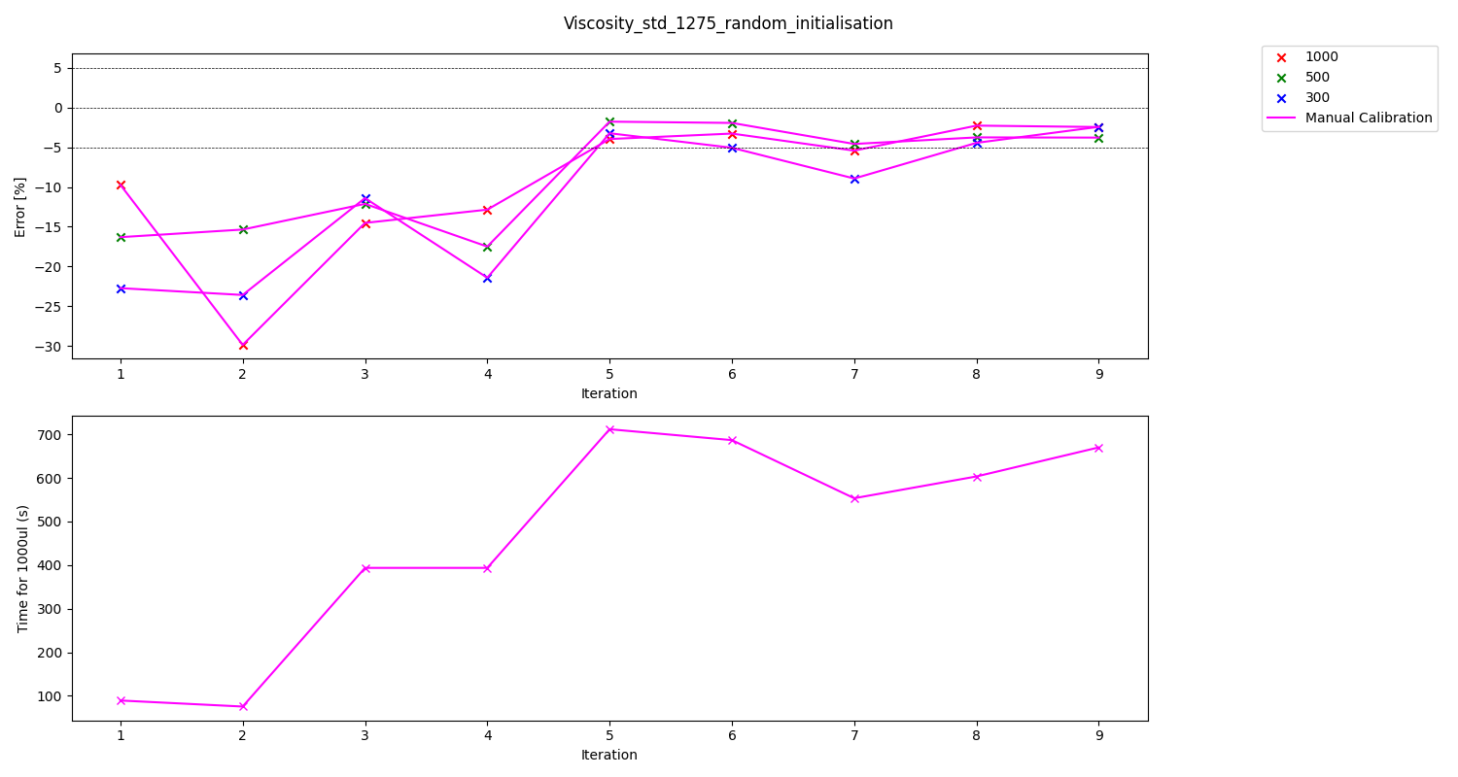
Graph of experiment results (Viscosity standard 1275 manual)
 | Parameters: |  |  |  |  | % error (blowouts before)
Viscosity standard: | Aspiration rate: | Dispense rate: | Delay aspirate: | Delay dispense: | Time for 1000ul | 1000(ul) | 500(ul) | 300(ul)
1275 | 4.0 | 2.5 | 10 | 10 | 670.000000 | -2.467078 | -3.796428 | -2.442059

